Slide 1

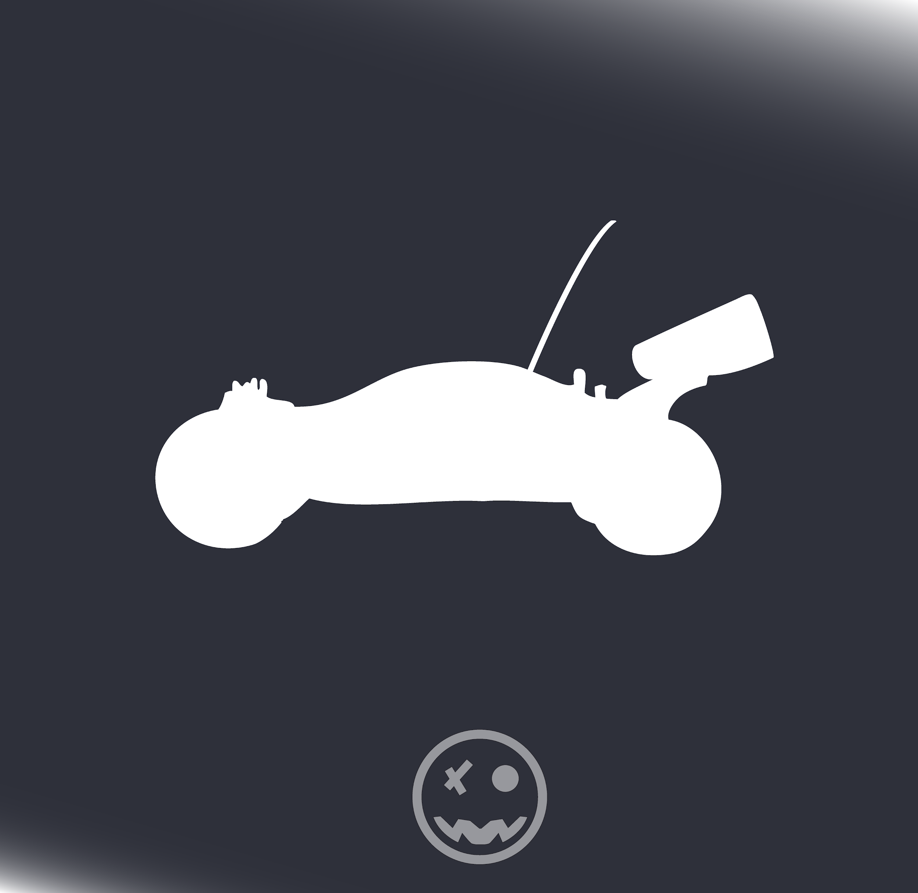
FPGAng’s
Controlled-Autonomous Rover
Ben Brown
Nicholas Arnold
Mohammed Uddin
Ganquan Wen
Zisen (Jason) Zhou

Slide 2

Overall Goals
Implement a “RC” Car using an FPGA with distinct modes
Controlled
Autonomous
Add unique peripherals
Bluetooth for controls & live stats
Ultrasonic Sensor/Light Sensor to detect environment
Motors to drive the rover
Main Features
Autonomous mode! Implement a decision making vehicle based on feedback from sensors
Using Verilog and the FPGA to handle interactions between different peripherals

Slide 3
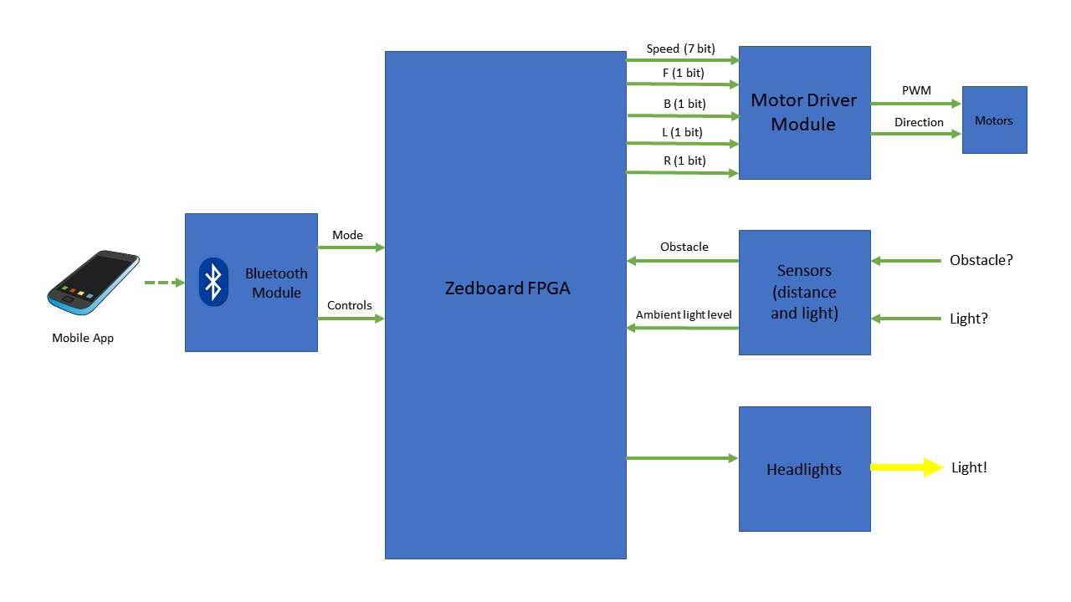
BLock Diagram of System

Slide 4
Motor Controls (Ben)
What is done?
Variable speed motor controller module
Successfully interfaced RC car motors with Nexsys 3 board and L293D motor driver (video)
What is being worked on now?
Fine tuning minimum and maximum speeds based on weight of Zedboard on top of car
Fine tuning PWM frequency to avoid motor whining
Planning out wiring from FPGA to L293D, motors, and battery pack
What is yet to be started?
Interfacing motor driver and motors with Zedboard
Take inputs from Bluetooth
Physical mount for L293D chip, sensors, and Zedboard

Slide 5
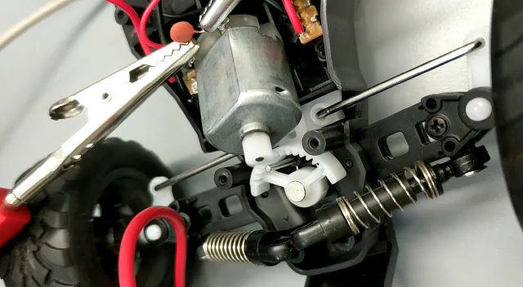
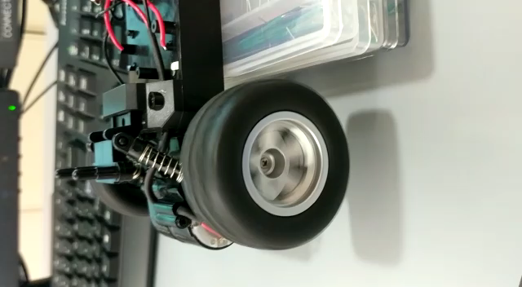
Video of Motor Controls

Slide 6
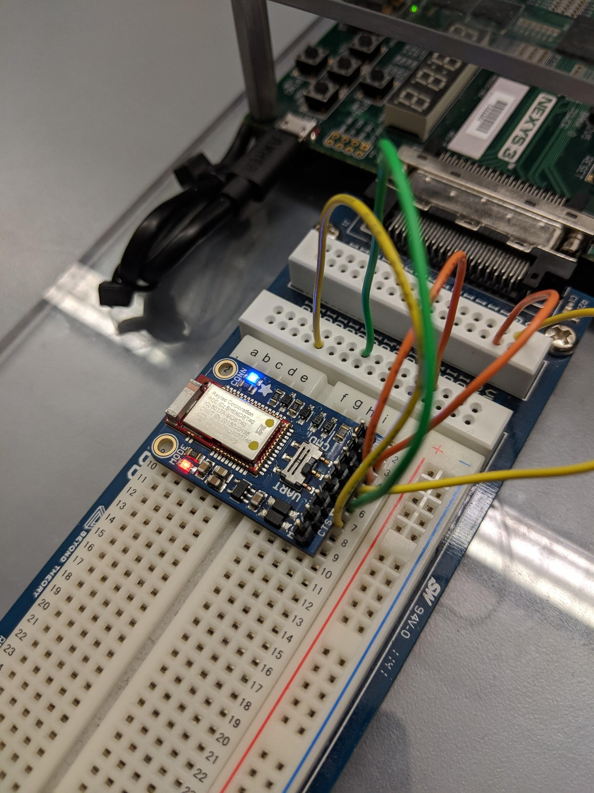
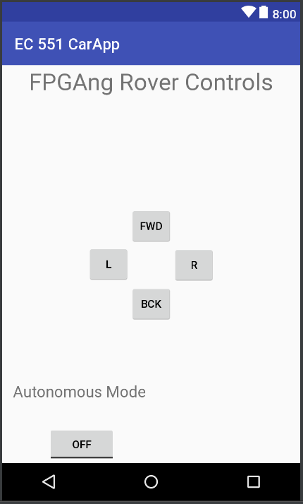
Bluetooth Control and Android App (Nick and Mo)
What is completed?
Basic Android App Interface
Bluetooth connectivity
Sending signals from phone to Adafruit Bluetooth chip
F,B,L,R buttons for directions + slider for speed
What is being worked on right now?
Connecting bluetooth module to the Zedboard via UART (currently testing on breadboard)
Test data rate, and clocking it appropriately (send signals fast enough / appropriate to communicate)
Modules to translate signal bytes into movement parameters
Down the road
Test controls with Ben’s modules and our modules on the Zedboard with verilog
Switch states between autonomous and controlled, tune decision making logic
Modules to take speed & sensor stats, communicate them to display on the phone

Slide 7
Sensors - Ultrasonic and Light (Gan and Jason)
What is completed?
Ultrasonic sensor can measure distance to the block in front of it.
The result can be displayed on the 7-segment. The accuracy is good.
What is being worked on right now?
Sometimes it gets incorrect result while the distance is changing. (We will see that on the video) We are trying to find out the cause of that and fix it.
Algorithm and priority of of five sensors.
Down the road
Implement five sonic sensors working at the same time.
The light sensor.
Test controls with other module

Slide 8
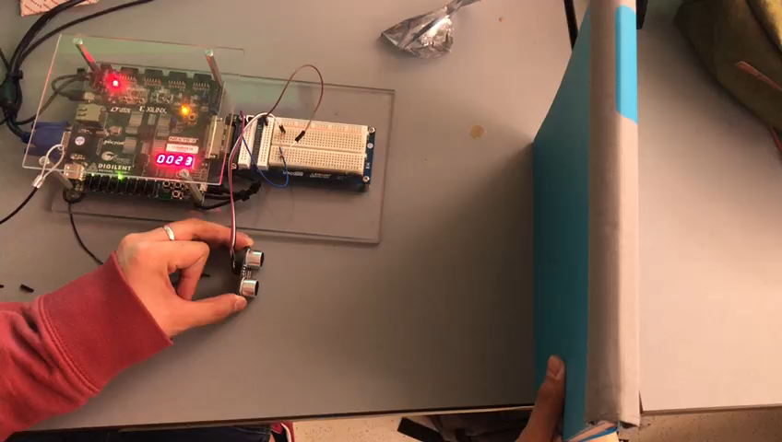
Videos of Testing Sensor

Slide 9
Things going well
Motor/Controls
Both the rear motor and motors for turning are simple DC motors, easy to drive and control
Bluetooth connectivity
Android Application
Sending strings/data to BT chip from phone
Data stream (send four 1-bit outputs for direction and either a 7-bit output for “levels” of speed)
Sensors
Testing ultrasonic sensor with 7-segment display

Slide 10
Things to improve on
Motor/Controls
Speed adjustments as programmed now might be too fine
Physical mounting may be too heavy
Bluetooth connectivity
Making sense of the data stream received from Bluetooth Module onto board’s UART
Converting the information received from the Bluetooth module to the board to something that can drive the car
Sensors
The stability of the distance measured
Making decisions based on the sensor feedback (autonomous mode)

Slide 11



Timeline
First Presentation
Order Parts
Controls Code
Materials Obtained
Functioning App with Bluetooth
Motors Steering Controls Implemented
Autonomous Mode
& Sensors
Integration and testing phase
Final Presentation
Demo
Feb 15th March 1st March 15th March 22nd April 1st April 15th Apr. 26th May 1st

Slide 12
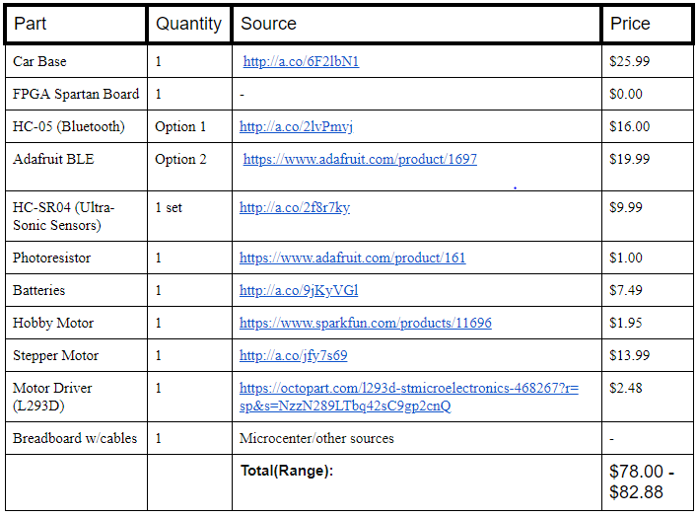

Bill of Materials
$97.65

Slide 13


Give us feedback!
Questions?

